Slide 1
Introduction to Transaction Processing Concepts and Theory

Slide 2
Introduction to Transaction Processing
Transaction: An executing program (process) that includes one or more database access operations
Read operations (database retrieval, such as SQL SELECT)
Write operations (modify database, such as SQL INSERT, UPDATE, DELETE)
Transaction: A logical unit of database processing
Example: Bank balance transfer of $100 dollars from a checking account to a saving account in a BANK database
Note: Each execution of a program is a distinct transaction with different parameters
Bank transfer program parameters: savings account number, checking account number, transfer amount

Slide 3
Introduction to Transaction Processing (cont.)
A transaction (set of operations) may be:
stand-alone, specified in a high level language like SQL submitted interactively, or
consist of database operations embedded within a program (most transactions)
Transaction boundaries: Begin and End transaction.
Note: An application program may contain several transactions separated by Begin and End transaction boundaries

Slide 4
Introduction to Transaction Processing (cont.)
Transaction Processing Systems: Large multi-user database systems supporting thousands of concurrent transactions (user processes) per minute
Two Modes of Concurrency
Interleaved processing: concurrent execution of processes is interleaved in a single CPU
Parallel processing: processes are concurrently executed in multiple CPUs (Figure 21.1)
Basic transaction processing theory assumes interleaved concurrency

Slide 5
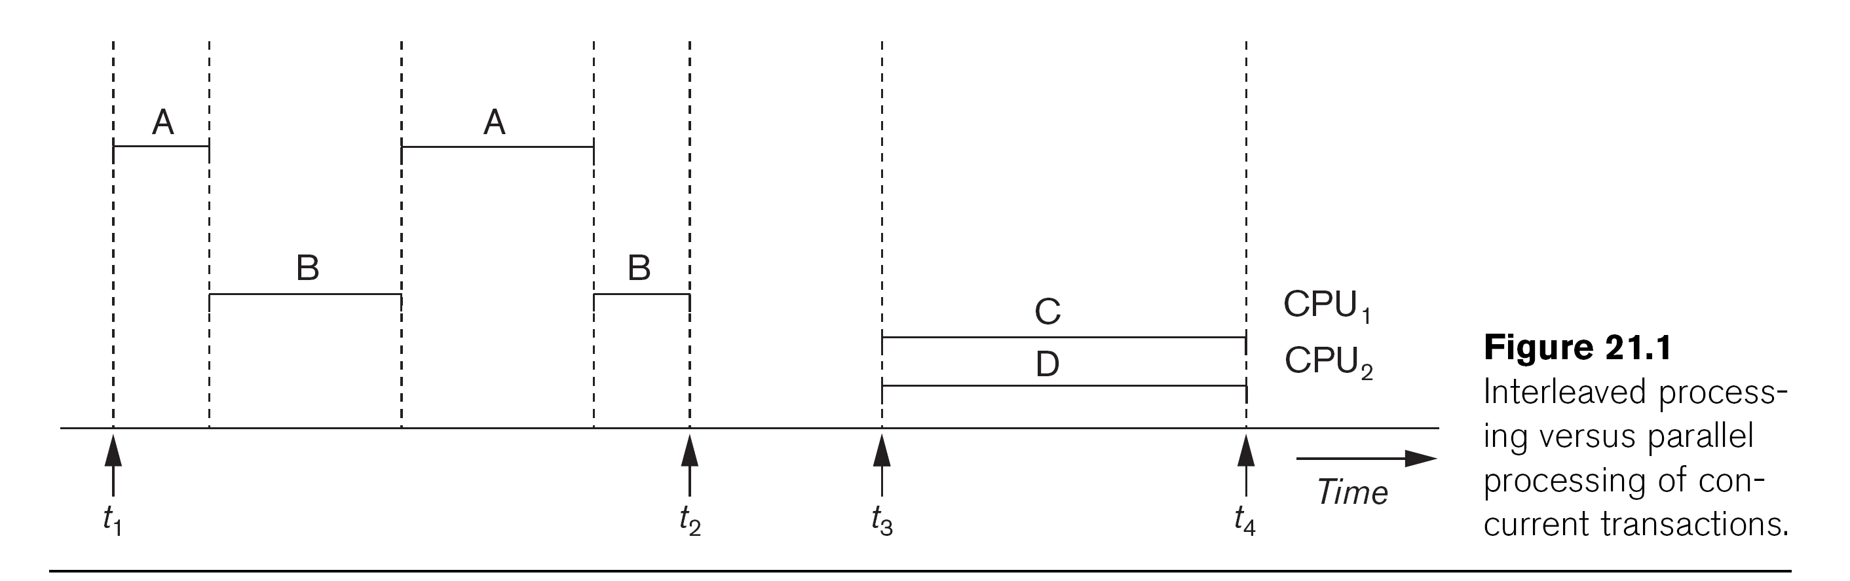

Slide 6
Introduction to Transaction Processing (cont.)
READ AND WRITE OPERATIONS:
Basic unit of data transfer from the disk to the computer main memory is one disk block (or page). A data item X (what is read or written) will usually be the field of some record in the database, although it may be a larger unit such as a whole record or even a whole block.
read_item(X) command includes the following steps:
Find the address of the disk block that contains item X.
Copy that disk block into a buffer in main memory (if that disk block is not already in some main memory buffer).
Copy item X from the buffer to the program variable named X.

Slide 7
Introduction to Transaction Processing (cont.)
READ AND WRITE OPERATIONS (cont.):
write_item(X) command includes the following steps:
Find the address of the disk block that contains item X.
Copy that disk block into a buffer in main memory (if it is not already in some main memory buffer).
Copy item X from the program variable named X into its correct location in the buffer.
Store the updated block from the buffer back to disk (either immediately or at some later point in time).

Slide 8
Transaction Notation
Figure below shows two examples of transactions
Notation focuses on the read and write operations
Can also write in shorthand notation:
T1: b1; r1(X); w1(X); r1(Y); w1(Y); e1;
T2: b2; r2(X); w2(X); e2;
bi and ei specify transaction boundaries (begin and end)
i specifies a unique transaction identifier (TId)

Slide 9
Transaction and System Concepts
A transaction is an atomic unit of work that is either completed in its entirety or not done at all. A transaction passes through several states.
Transaction states:
Active state (executing read, write operations)
Partially committed state (ended but waiting for system checks to determine success or failure)
Committed state (transaction succeeded)
Failed state (transaction failed, must be rolled back)
Terminated State (transaction leaves system)

Slide 10
Desirable Properties of Transactions
Called ACID properties – Atomicity, Consistency, Isolation, Durability:
Atomicity: A transaction is an atomic unit of processing; it is either performed in its entirety or not performed at all. Enforced by the recovery protocol.
Consistency preservation: A correct execution of the transaction must take the database from one consistent state to another.
Specifies that each transaction does a correct action on the database on its own. Application programmers and DBMS constraint enforcement are responsible for this.

Slide 11
Desirable Properties of Transactions (cont.)
ACID properties (cont.):
Isolation: Even though transactions are executing concurrently, they should appear to be executed in isolation – that is, their final effect should be as if each transaction was executed in isolation from start to finish.
Responsibility of the concurrency control protocol.
Durability or permanency: Once a transaction is committed, its changes (writes) applied to the database must never be lost because of subsequent failure. Enforced by the recovery protocol.

Slide 12
Schedules of Transactions
Transaction schedule (or history): When transactions are executing concurrently in an interleaved fashion, the order of execution of operations from the various transactions forms what is known as a transaction schedule (or history).
Figure 21.5 (next slide) shows 4 possible schedules (A, B, C, D) of two transactions T1 and T2:
Order of operations from top to bottom
Each schedule includes same operations
Different order of operations in each schedule

Slide 13
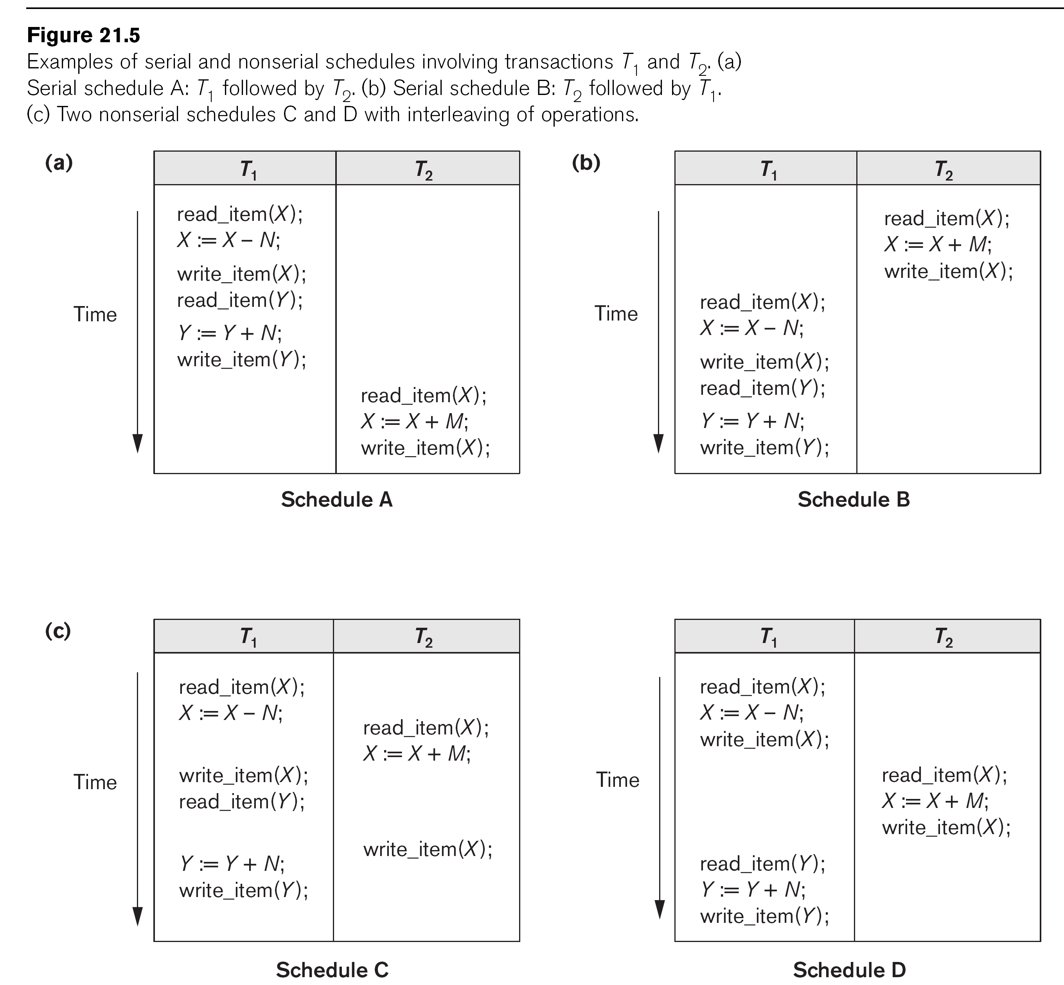

Slide 14
Schedules of Transactions (cont.)
Schedules can also be displayed in more compact notation
Order of operations from left to right
Include only read (r) and write (w) operations, with transaction id (1, 2, …) and item name (X, Y, …)
Can also include other operations such as b (begin), e (end), c (commit), a (abort)
Schedules in Figure 21.5 would be displayed as follows:
Schedule A: r1(X); w1(X); r1(Y); w1(Y); r2(X); w2(x);
Schedule B: r2(X); w2(X); r1(X); w1(X); r1(Y); w1(Y);
Schedule C: r1(X); r2(X); w1(X); r1(Y); w2(X); w1(Y);
Schedule D: r1(X); w1(X); r2(X); w2(X); r1(Y); w1(Y);

Slide 15
Schedules of Transactions (cont.)
Formal definition of a schedule (or history) S of n transactions T1, T2, ..., Tn :
An ordering of all the operations of the transactions subject to the constraint that, for each transaction Ti that participates in S, the operations of Ti in S must appear in the same order in which they occur in Ti.
Note: Operations from other transactions Tj can be interleaved with the operations of Ti in S.

Slide 16
Schedules of Transactions (cont.)
For n transactions T1, T2, ..., Tn, where each Ti has mi read and write operations, the number of possible schedules is (! is factorial function):
(m1 + m2 + … + mn)! / ( (m1)! * (m2)! * … * (mn)! )
Generally very large number of possible schedules
Some schedules are easy to recover from after a failure, while others are not
Some schedules produce correct results, while others produce incorrect results
Rest of chapter characterizes schedules by classifying them based on ease of recovery (recoverability) and correctness (serializability)

Slide 17
Characterizing Schedules based on Recoverability
Schedules classified into two main classes:
Recoverable schedule: One where no committed transaction needs to be rolled back (aborted).
A schedule S is recoverable if no transaction T in S commits until all transactions T’ that have written an item that T reads have committed.
Non-recoverable schedule: A schedule where a committed transaction may have to be rolled back during recovery.
This violates Durability from ACID properties (a committed transaction cannot be rolled back) and so non-recoverable schedules should not be allowed.

Slide 18
Characterizing Schedules Based on Recoverability (cont.)
Example: Schedule A below is non-recoverable because T2 reads the value of X that was written by T1, but then T2 commits before T1 commits or aborts
To make it recoverable, the commit of T2 (c2) must be delayed until T1 either commits, or aborts (Schedule B)
If T1 commits, T2 can commit
If T1 aborts, T2 must also abort because it read a value that was written by T1; this value must be undone (reset to its old value) when T1 is aborted
known as cascading rollback
Schedule A: r1(X); w1(X); r2(X); w2(X); c2; r1(Y); w1(Y); c1 (or a1)
Schedule B: r1(X); w1(X); r2(X); w2(X); r1(Y); w1(Y); c1 (or a1); ...

Slide 19
Characterizing Schedules based on Recoverability (cont.)
Recoverable schedules can be further refined:
Cascadeless schedule: A schedule in which a transaction T2 cannot read an item X until the transaction T1 that last wrote X has committed.
The set of cascadeless schedules is a subset of the set of recoverable schedules.
Schedules requiring cascaded rollback: A schedule in which an uncommitted transaction T2 that read an item that was written by a failed transaction T1 must be rolled back.

Slide 20
Characterizing Schedules Based on Recoverability (cont.)
Example: Schedule B below is not cascadeless because T2 reads the value of X that was written by T1 before T1 commits
If T1 aborts (fails), T2 must also be aborted (rolled back) resulting in cascading rollback
To make it cascadeless, the r2(X) of T2 must be delayed until T1 commits (or aborts and rolls back the value of X to its previous value) – see Schedule C
Schedule B: r1(X); w1(X); r2(X); w2(X); r1(Y); w1(Y); c1 (or a1);
Schedule C: r1(X); w1(X); r1(Y); w1(Y); c1; r2(X); w2(X); ...

Slide 21
Characterizing Schedules based on Recoverability (cont.)
Cascadeless schedules can be further refined:
Strict schedule: A schedule in which a transaction T2 can neither read nor write an item X until the transaction T1 that last wrote X has committed.
The set of strict schedules is a subset of the set of cascadeless schedules.
If blind writes are not allowed, all cascadeless schedules are also strict
Blind write: A write operation w2(X) that is not preceded by a read r2(X).

Slide 22
Characterizing Schedules Based on Recoverability (cont.)
Example: Schedule C below is cascadeless and also strict (because it has no blind writes)
Schedule D is cascadeless, but not strict (because of the blind write w3(X), which writes the value of X before T1 commits)
To make it strict, w3(X) must be delayed until after T1 commits – see Schedule E
Schedule C: r1(X); w1(X); r1(Y); w1(Y); c1; r2(X); w2(X); …
Schedule D: r1(X); w1(X); w3(X); r1(Y); w1(Y); c1; r2(X); w2(X); …
Schedule E: r1(X); w1(X); r1(Y); w1(Y); c1; w3(X); r2(X); w2(X); …

Slide 23
Characterizing Schedules based on Serializability
Among the large set of possible schedules, we want to characterize which schedules are guaranteed to give a correct result
The consistency preservation property of the ACID properties states that: each transaction if executed on its own (from start to finish) will transform a consistent state of the database into another consistent state
Hence, each transaction is correct on its own

Slide 24
Characterizing Schedules based on Serializability (cont.)
Serial schedule: A schedule S is serial if, for every transaction T participating in the schedule, all the operations of T are executed consecutively (without interleaving of operations from other transactions) in the schedule. Otherwise, the schedule is called nonserial.
Based on the consistency preservation property, any serial schedule will produce a correct result (assuming no inter-dependencies among different transactions)

Slide 25
Characterizing Schedules based on Serializability (cont.)
Serial schedules are not feasible for performance reasons:
No interleaving of operations
Long transactions force other transactions to wait
System cannot switch to other transaction when a transaction is waiting for disk I/O or any other event
Need to allow concurrency with interleaving without sacrificing correctness

Slide 26
Characterizing Schedules based on Serializability (cont.)
Serializable schedule: A schedule S is serializable if it is equivalent to some serial schedule of the same n transactions.
There are (n)! serial schedules for n transactions – a serializable schedule can be equivalent to any of the serial schedules
Question: How do we define equivalence of schedules?

Slide 27
Types of Serializability
Serializability of any non-serial schedule can be verified using two types:
Conflict Serializability
View Serializability.

Slide 28
Conflict Serializability
Conflict Serializability: A non-serial schedule is a conflict serializable if, after performing some swapping on the non-conflicting operation results in a serial schedule. It is checked using the non-serial schedule and an equivalent serial schedule. This process of checking is called Conflict Serializability in DBMS .
It is tedious to use if we have many operations and transactions as it requires a lot of swapping.
For checking, we will use the Precedence Graph technique (discussed later in slide number 36).

Slide 29
Equivalence of Schedules (cont.)
Conflict equivalent: Two schedules are conflict equivalent if the relative order of any two conflicting operations is the same in both schedules.
Commonly used definition of schedule equivalence
Two operations are conflicting if:
They access the same data item X
They are from two different transactions
At least one is a write operation
Read-Write conflict example: r1(X) and w2(X)
Write-write conflict example: w1(Y) and w2(Y)
Write-Read conflict example: w1(X) and r2(X)

Slide 30
Equivalence of Schedules (cont.)
Changing the order of conflicting operations generally causes a different outcome
Example: changing r1(X); w2(X) to w2(X); r1(X) means that T1 will read a different value for X
Example: changing w1(Y); w2(Y) to w2(Y); w1(Y) means that the final value for Y in the database can be different
Note that read operations are not conflicting; changing r1(Z); r2(Z) to r2(Z); r1(Z) does not change the outcome

Slide 31
Characterizing Scedules Based on Serializability (cont.)
Conflict equivalence of schedules is used to determine which schedules are correct in general (serializable)
A schedule S is said to be serializable if it is conflict equivalent to some serial schedule S’.

Slide 32
Characterizing Schedules based on Serializability (cont.)
A serializable schedule is considered to be correct because it is equivalent to a serial schedule, and any serial schedule is considered to be correct
It will leave the database in a consistent state.
The interleaving is appropriate and will result in a state as if the transactions were serially executed, yet will achieve efficiency due to concurrent execution and interleaving of operations from different transactions.

Slide 33
Benefits of Serializability in DBMS
Now that we understand the serializability in DBMS let's look at some benefits of Serializability in DBMS.
Predictable Executions: Since all threads are executed one at a time, there are no surprises. All variables are updated as expected, and no data is lost or corrupted.
Easier to Reason about & Debug: As each thread is executed alone, it is easier to reason about what each thread is doing and why. This can make debugging much easier since you don't have to worry about concurrency issues.
Reduced Costs: Serialization in DBMS can help reduce hardware costs by allowing fewer resources to be used for a given computation (e.g., only one CPU instead of two). Additionally, it can help reduce software development costs by making it easier to reason about code and reducing the need for extensive testing with multiple threads running concurrently.
Increased Performance: In some cases, serializable executions can perform better than their non-serializable counterparts since they allow the developer to optimize their code for performance.
Maintain Consistency in the database: Due to serializability, non-serial schedule maintain a consistency in the database.

Slide 34
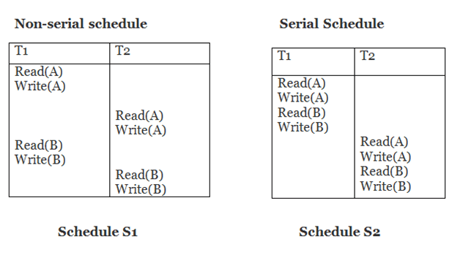
Conflict Equivalent

Slide 35
Conflict Equivalent Con’t..
After swapping of non-conflict operations, the schedule S1 becomes conflict equivalent as shown below:
T1 | T2
Read(A) Write(A) Read(B) Write(B) | Read(A) Write(A) Read(B) Write(B)

Slide 36
Testing for Conflict Serializability
To test the serializability of a schedule, we can use Serialization Graph or Precedence Graph. A serialization Graph is nothing but a Directed Graph of the entire transactions of a schedule.
It can be defined as a Graph G(V, E) consisting of a set of directed-edges E = {E1, E2, E3, ..., En} and a set of vertices V = {V1, V2, V3, ...,Vn}. The set of edges contains one of the two operations - READ, WRITE performed by a certain transaction.

Slide 37
Testing for Conflict Serializability
Serialization Graph is used to test the Serializability of a schedule.
Assume a schedule S. For S, we construct a graph known as precedence graph. This graph has a pair G = (V, E), where V consists a set of vertices, and E consists a set of edges. The set of vertices is used to contain all the transactions participating in the schedule. The set of edges is used to contain all edges Ti ->Tj for which one of the three conditions holds:
Create a node Ti → Tj if Ti executes write (Q) before Tj executes read (Q).
Create a node Ti → Tj if Ti executes read (Q) before Tj executes write (Q).
Create a node Ti → Tj if Ti executes write (Q) before Tj executes write (Q).

Slide 38
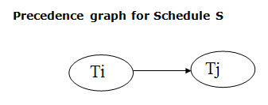
Precedence graph
If a precedence graph contains a single edge Ti → Tj, then all the instructions of Ti are executed before the first instruction of Tj is executed.
If a precedence graph for schedule S contains a cycle, then S is non-serializable. If the precedence graph has no cycle, then S is known as serializable.

Slide 39
Example
T1 | T2 | T3
R(x)
 |  | R(z)
 |  | W(z)
 | R(y)
R(y)
 | W(y)
 |  | W(x)
 | W(z)
W(x)

Slide 40
Example, con’t…
Non-serializable schedule. R(x) of T1 conflicts with W(x) of T3, so there is a directed edge from T1 to T3. R(y) of T1 conflicts with W(y) of T2, so there is a directed edge from T1 to T2. W(x) of T3 conflicts with W(x) of T1, so there is a directed edge from T3 to T1. Similarly, we will make edges for every conflicting pair. Now, as the cycle is formed, the transactions cannot be conflict serializable.

Slide 41
View Serializability
The View serializability is a concept that is used to compute whether schedules are View-Serializable or not.
A schedule is said to be View-Serializable if it is view equivalent to a Serial Schedule (where no interleaving of transactions is possible).
There may be some schedules that are not Conflict-Serializable but still gives a consistent result.
In such a case we cannot predict whether a schedule would be consistent or inconsistent.
For Conflict-Serializability, we can say that a schedule is Not Conflict-Serializable if a schedule’s precedence graph contains a cycle/loop but it may results in serializable schedule.
So, to address such cases we use the concept of View-Serializability.

Slide 42
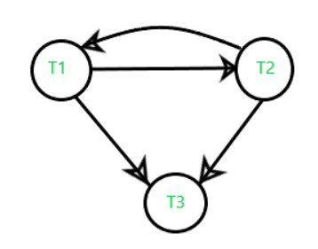
View Serializability
Example: Schedule S
Conflict Precedence Graph
T₁ | T₂ | T₃
a=100 read(a)
 | a=a-40 write(a) //60
a=a-40 write(a) //20
 |  | a=a-20 write(a) //0
Here, graph contains cycle/loop which means it is not conflict-serializable but it does not mean that it cannot be consistent and equivalent to the serial schedule

Slide 43
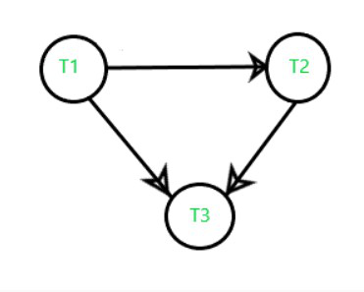
View Serializability
Example: Schedule S’
In the previous example (S) if we do swapping among some transaction’s operation so our table will be:
Its Precedence Graph is
T₁ | T₂ | T₃
a=100 read(a) //100
a=a-40 write(a) //60
 | a=a-40 write(a) //20
 |  | a=a-20 write(a) //0
The graph does not contain any cycle/loop, which means it is conflict serializable (equivalent to serial schedule, consistent) and the final result is coming the same as the first table.
i.e. operation a=a-20 results in a= 0 which is same as previous schedule.

Slide 44
View Serializability
If a schedule is Conflict-serializable so we can say that It would be –
Equivalent to a serial schedule,
Consistent, and
also a View-Serializable.
But what if it is non-conflict serializable (precedence graph contains loop). In this situation, we cannot predict whether it is consistent and serializable or not.
We have to check for the schedule for View Serializability. The schedule may or may not be view serializable.

Slide 45
View Serializability
How to ensure a schedule is view serializable or not?
First of all, check whether the given schedule is Non-Conflict Serializable or Conflict-Serializable.
If the given schedule is conflict serializable then the given schedule must be a view serializable.
If the given schedule is non-conflict serializable, then it may or may not be view serializable.
If NO BLIND WRITES exists, then the schedule must be a non-View-Serializable schedule.
If there exists any blind write, then, in that case, the schedule may or may not be view serializable.
Blind write: Performing the Writing operation (updation), without reading operation on a data is known as a blind write.

Slide 46
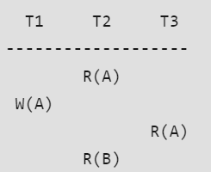
View Serializability
Condition of schedules to View-equivalent
View Serializability: A Schedule is called view serializable if it is view equal to a serial schedule.
Two schedules S1 and S2 are said to be view-equivalent if the below conditions are satisfied:
Initial Read: If a transaction T1 reads data item A from the database in S1 then in S2 also T1 should read A from database.
Here, Transaction T2 is reading A from the database.

Slide 47
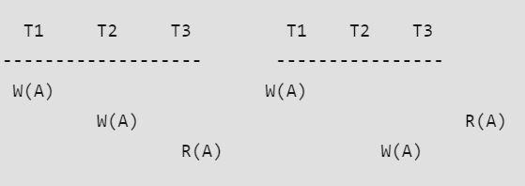
View Serializability
Condition of schedules to View-equivalent
Two schedules S1 and S2 are said to be view-equivalent if the below conditions are satisfied :
2) Updated Read: If Ti is reading A which is updated by Tj in S1 then in S2 also Ti should read A which is updated by Tj.
Above two schedules are not view-equivalent as in S1:T3 is reading A updated by T2, in S2 T3 is reading A updated by T1.

Slide 48
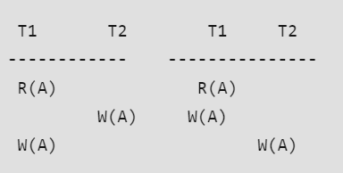
View Serializability
Condition of schedules to View-equivalent
Two schedules S1 and S2 are said to be view-equivalent if the below conditions are satisfied :
3) Final Write operation: If a transaction T1 updated A at last in S1, then in S2 also T1 should perform final write operations.
Above two schedules are not view-equivalent as Final write operation in S1 is done by T1 while in S2 done by T2.

Slide 49
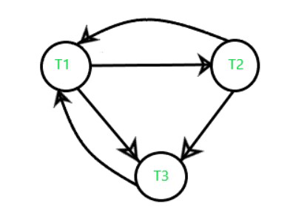
View Serializability
Example:
S: read1(A), write2(A), read3(A), write1(A), write3(A)
T₁ | T₂ | T₃
read(a)
 | write(a)
 |  | read(a)
write(a)
 |  | write(a)
Conflict Precedence Graph
it is conflict serializable
Check whether the Schedule S contains any blind write?
We found that the schedule S contains a blind-write write2(a) in transaction T2.
Therefore, the schedule S may or may not be View-Serializable.
Now, we will check for view equivalent schedule.

Slide 50
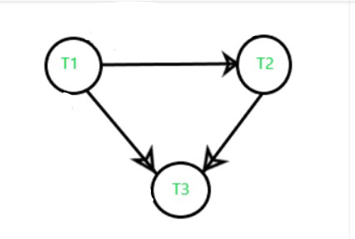
View Serializability
Example:
S: read1(A), write2(A), read3(A), write1(A), write3(A)
T₁ | T₂ | T₃
read(a)
 | write(a)
 |  | read(a)
write(a)
 |  | write(a)
Transaction T₁ first reads data_item “a” and transaction T₂ first updates(write) “a”.
So, the transaction T₁ must execute before T₂.
In that way, we get the dependency (T₁ → T₂) in the graph.
And, the final update(write) on “a” is made by transaction T₃.
So, transaction T₃ must execute after all the other transactions(T₁, T₂).
Thus, we get the dependency (T₁, T₂) → T₃ in the graph shown below:
As there is no cycle/loop in the dependency graph, the schedule S’ is View-Serializable.

Slide 51
Thank You

